Slide 1
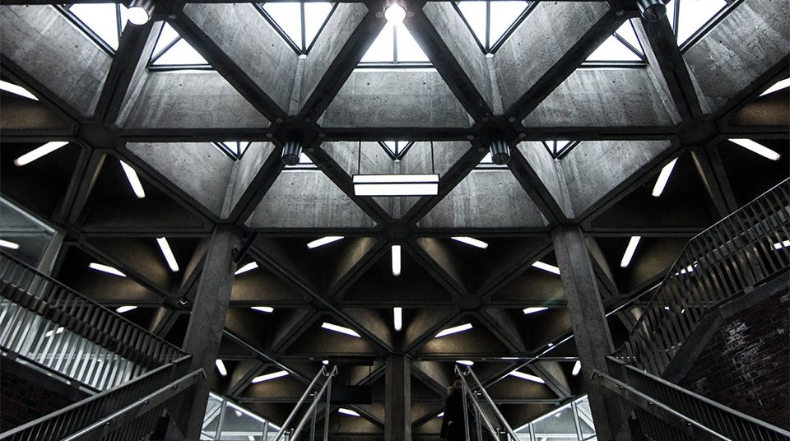
Machine Learning for Algorithmic Trading
AMLD Africa
By Mouafek Ayadi
Data Scientist at ODDO BHF
AMLD Africa

Slide 2

Title:
Table of Contents
1- Algorithmic Trading
2- ML for Algo-Trading (Wide & Deep Learning)
3- ML for Algo-Trading (Deep Reinforcement Learning)
4- ML for Algo-Trading (Wide & Deep Reinforcement Learning)
5- The Sustainable Development in Africa
6- References
7- Conclusions and Perspectives

Slide 3
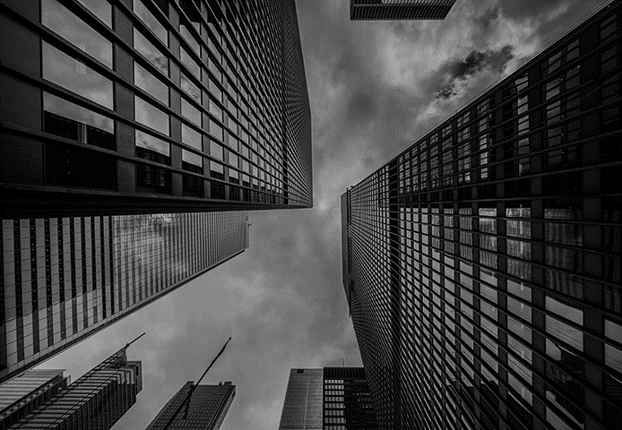
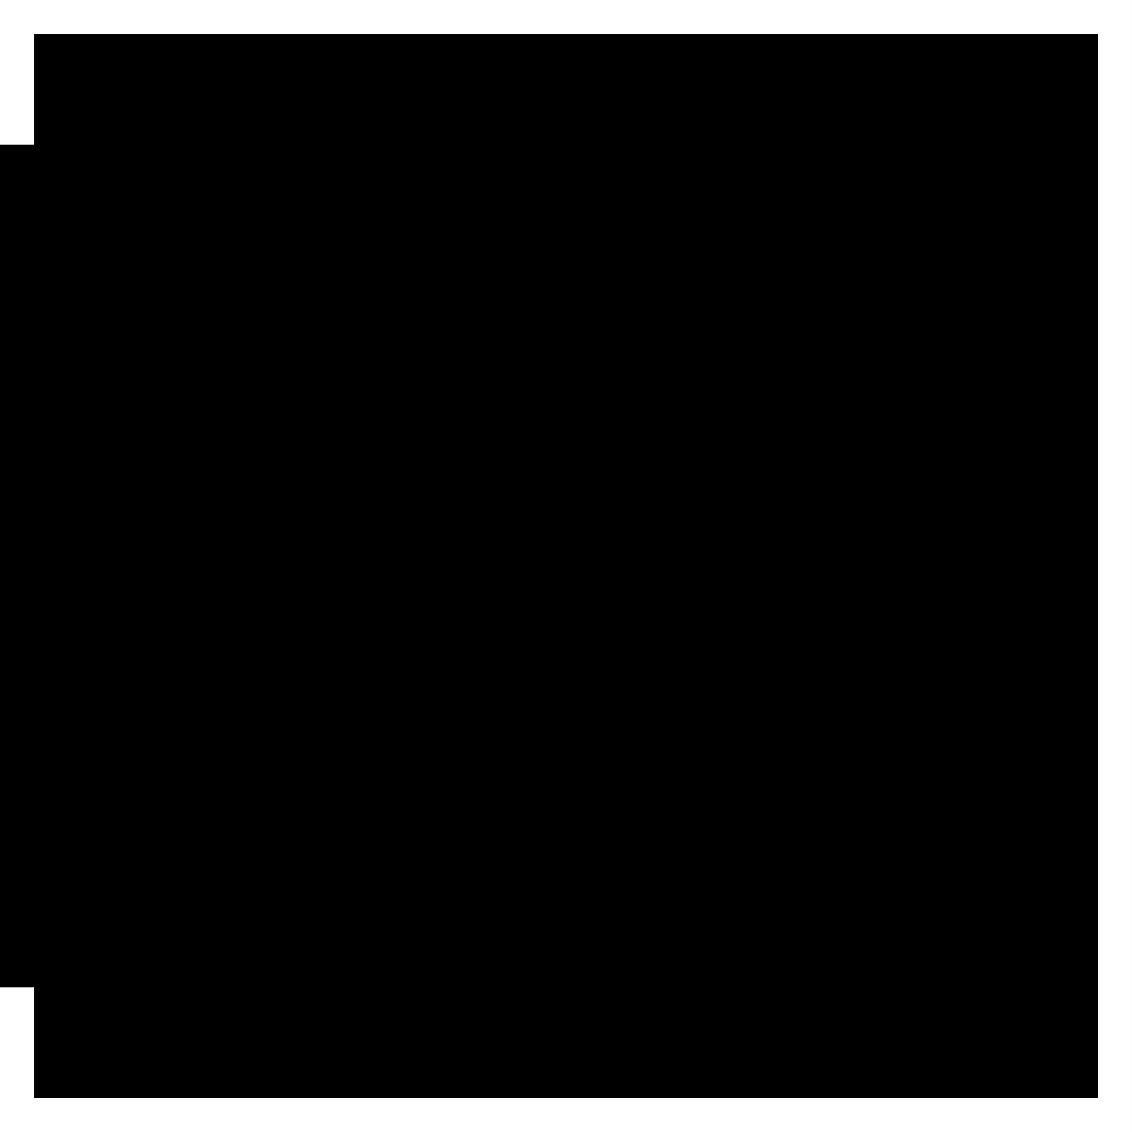
Algorithmic Trading

Slide 4
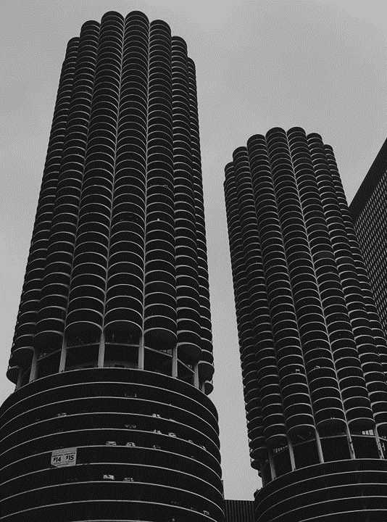
Algorithmic Trading
Introduction
“Algorithmic trading is a type of quant trading that uses pre-specified machine executable instructions to determine the size and timing of trades based on a quantitative model of an asset's price behavior. Over 70 percent of US trading volume is algorithmic. Most of this volume is high-frequency trading.”[1]
Notes:
[1]
Jack Farmer
Academic Director at New York Institute of Finance
https://www.coursera.org/specializations/machine-learning-trading

Slide 5
Algorithmic Trading
With Machine Learning
“Machine learning (ML) involves algorithms that learn rules or patterns from data to achieve a goal such as minimizing a prediction error. ML algorithms can extract information from data to support or automate key investment activities. These activities include observing the market and analyzing data to form expectations about the future and decide on placing buy or sell orders, as well as managing the resulting portfolio to produce attractive returns relative to the risk.”[2]
Notes:
[2]
Stefan Jansen, founder and Lead Data Scientist at Applied AI.
https://ml4trading.io/chapter/0

Slide 6
ML for Algo-Trading Wide & Deep Learning

Slide 7
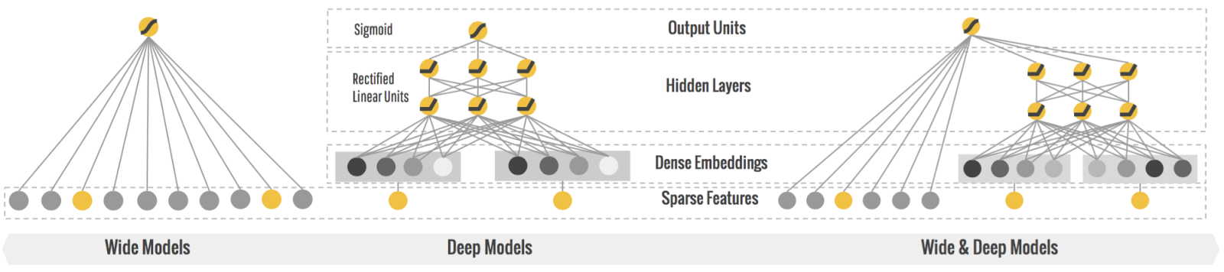
Wide & Deep Learning
“Can we teach computers to learn like humans do, by combining the power of memorization and generalization?” [3]
Wide & Deep Learning developed at Google Research was the answer to the previous question.
“It's not an easy question to answer, but by jointly training a wide linear model (for memorization) alongside a deep neural network (for generalization), one can combine the strengths of both to bring us one step closer.” [3]
“It's useful for generic large-scale regression and classification problems with sparse inputs (categorical features with a large number of possible feature values), such as recommender systems, search, and ranking problems.” [3]
AMLD Africa
Notes:
[3]
Wide & Deep Learning for Recommender Systems
https://arxiv.org/pdf/1606.07792.pdf
https://ai.googleblog.com/2016/06/wide-deep-learning-better-together-with.html

Slide 8
ML for Algo-Trading Deep Reinforcement Learning

Slide 9
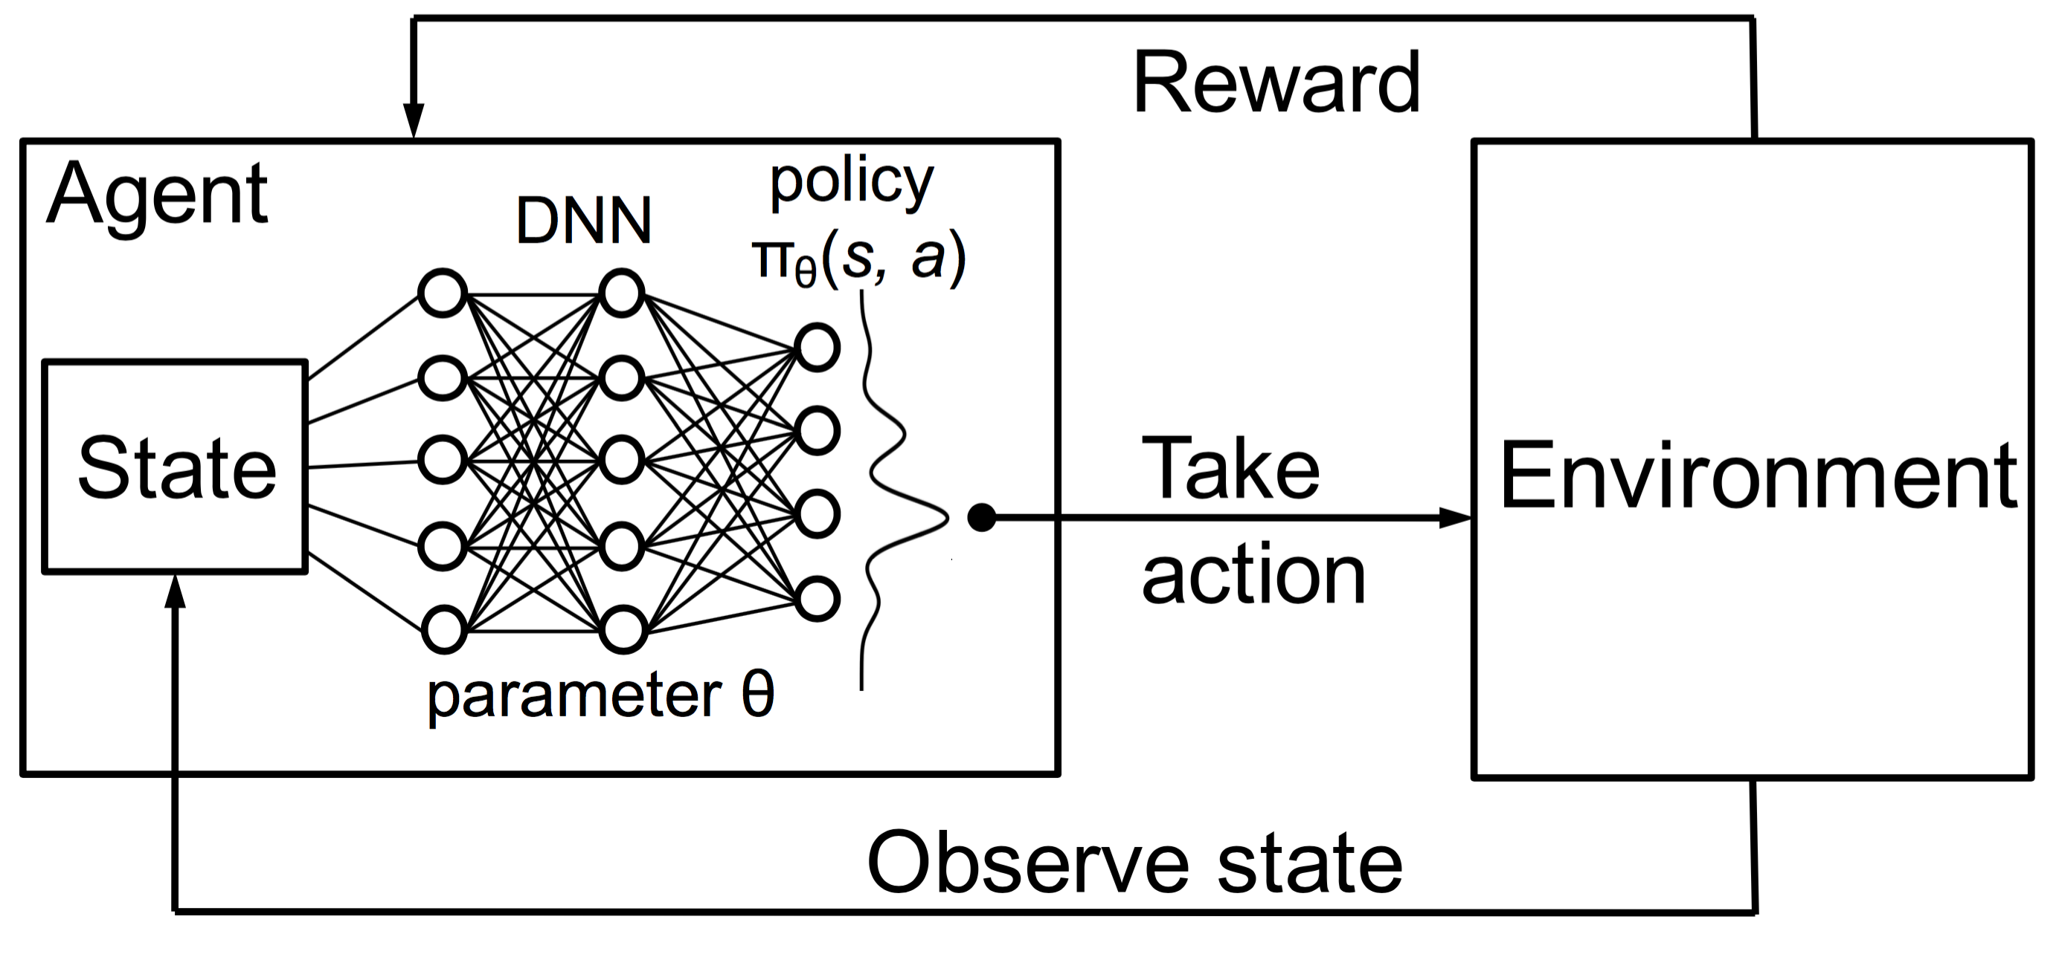
Deep Reinforcement Learning
Introduction
“Deep reinforcement learning is the combination of reinforcement learning (RL) and deep learning. This field of research has been able to solve a wide range of complex decision-making tasks that were previously out of reach for a machine.
Thus, Deep RL opens up many new applications in domains such as healthcare, robotics, smart grids, finance, and many more.” [4]
Notes:
[4]
Vincent Francois-Lavet, An Introduction to Deep Reinforcement Learning
https://arxiv.org/abs/1811.12560

Slide 10
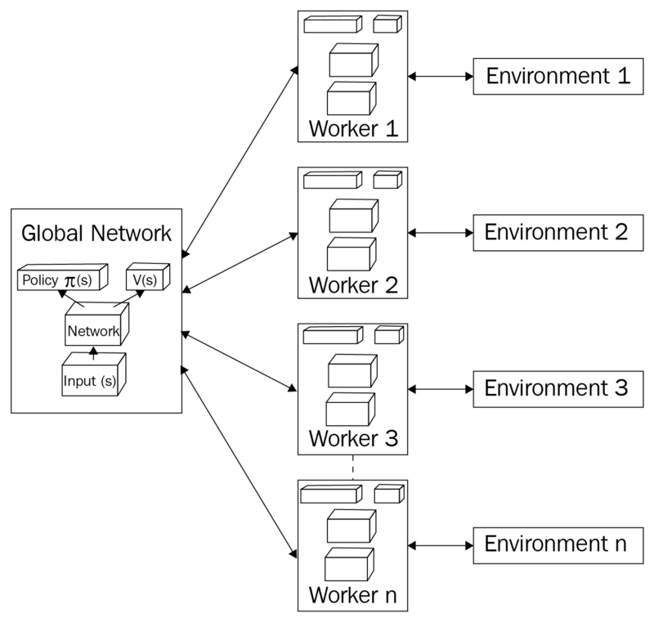
Deep Reinforcement Learning
A3C
The Asynchronous Advantage Actor Critic (A3C) was developed by Google's DeepMind.
A3C consists of multiple independent agents(networks) with their own weights, who interact with a different copy of the environment in parallel.
“We now describe our variants of one-step Q-learning, one-step Sarsa, n-step Q-learning and advantage actor-critic”. [5]
Notes:
[5]
Asynchronous Methods for Deep Reinforcement Learning
https://arxiv.org/pdf/1602.01783.pdf
The actor takes as input the state and outputs the best action. It essentially controls how the agent behaves by learning the optimal policy (policy-based).
The critic, on the other hand, evaluates the action by computing the value function (value based).
Those two models participate in a game where they both get better in their own role as the time passes.
The result is that the overall architecture will learn to play the game more efficiently than the two methods separately.
Policy-based are better for continuous and stochastic environments, have a faster convergence, while Value based are more sample efficient and steady.
https://theaisummer.com/Actor_critics/
But let’s get back to Reinforcement Learning. A good analogy of the actor-critic is a young boy with his mother. The child (actor) constantly tries new things and exploring the environment around him. He eats its own toys, he touches the hot oven, he bangs his head in the wall (I mean why not). His mother (the critic) watches him and either criticize or compliment him. The child listen to what his mother told him and adjust his behavior. As the kid grows, he learns what actions are bad or good and he essentially learns to play the game called life. That’s exactly the same way actor-critic works.
https://theaisummer.com/Actor_critics/
The actor can be a function approximator like a neural network and its task is to produce the best action for a given state. Of course, it can be a fully connected neural network or a convolutional or anything else. The critic is another function approximator, which receives as input the environment and the action by the actor, concatenates them and output the action value (Q-value) for the given pair. Let me remind you for a sec that the Q value is essentially the maximum future reward.
https://theaisummer.com/Actor_critics/

Slide 11
ML for Algo-Trading A3C with Wide & Deep Networks

Slide 12
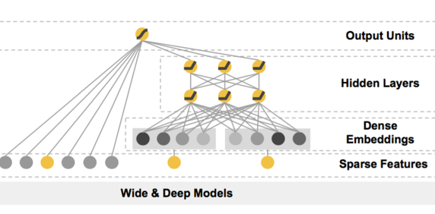
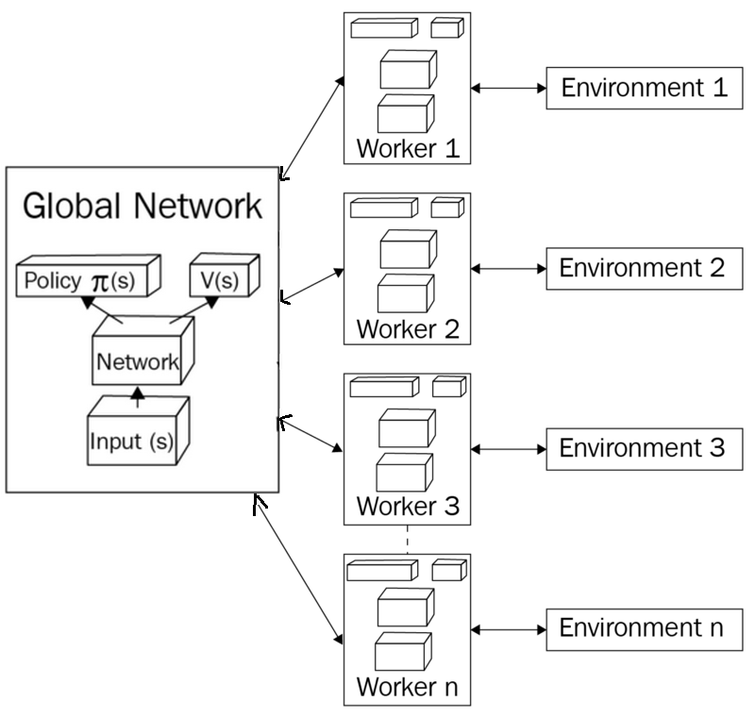
Deep Reinforcement Learning for Trading
A3C with Wide & Deep Networks
In a single financial market we can implement A3C that consists of multiple independent agents(networks) with their own weights that can operate in different sectors, who interact with a different copy of the environment in parallel used to simulate different sector scenarios.
Our idea is to make the Model-Free A3C bound by the market previous behavior and current trends, in order to predict seconds ahead of recent stock values. This will rely on the Wide & Deep Artificial Neural for approximating both the Actor and the Critic.
In order to make the Artificial Neural Network more compliant with the Financial markets and their respective sectors where the agents operates in, we define a Wide & Deep Models, where wide linear model is used for memorization (historical market data/sector pattern),
alongside a deep neural network used for generalization (detect new market/sector pattern).
AMLD Africa
Notes:
In reinforcement learning (RL), a model-free algorithm (as opposed to a model-based one) is an algorithm which does not use the transition probability distribution (and the reward function) associated with the Markov decision process (MDP), which, in RL, represents the problem to be solved.
The transition probability distribution (or transition model) and the reward function are often collectively called the "model" of the environment (or MDP), hence the name "model-free". A model-free RL algorithm can be thought of as an "explicit" trial-and-error algorithm.
An example of a model-free algorithm is Q-learning.

Slide 13
Sustainable Development in Africa
The Projected Impact

Slide 14
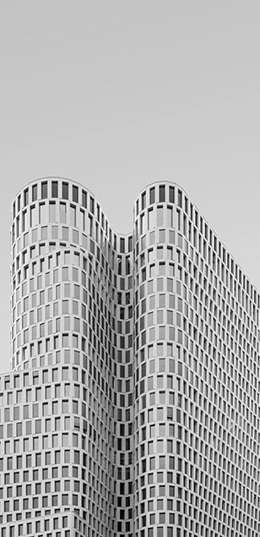
Title
Current Standings
Projected Impact
Tailored Algo-Trading solutions due exist, but only for B2B service, or through a physical brokers and agencies.
In Africa rare B2C service Startups and Financial institutions provide online platforms for Trading.
Public online AI powered trading platforms are almost unheard of in Africa and especially in Tunisia.
Our region is virgin terrain to have such an investment due to the presence of AI talent and market potential.
The proposed algo idea is to be deployed on digital platforms to democratize trading by providing a B2C service.
Having an AI powered trading platforms is a leap in the Africans continent financial services sector.
Moreover, if it’s open for the public as a B2C service it will be a game change for financial market passionate individuals.
Shift from human based trading system based on their intuition to AI centered data driven trading system.

Slide 15
Title:
Personal Work (ongoing)
https://github.com/MWFK/Market_Prediction-Building_Trading_Strategies
References
[1] Jack Farmer,
Academic Director at New York Institute of Finance
https://www.coursera.org/specializations/machine-learning-trading
[2] Stefan Jansen,
Founder and Lead Data Scientist at Applied AI.
https://ml4trading.io/chapter/0
[3] Wide & Deep Learning for Recommender Systems
https://arxiv.org/pdf/1606.07792.pdf
https://ai.googleblog.com/2016/06/wide-deep-learning-better-together-with.html
[4] Vincent Francois-Lavet,
An Introduction to Deep Reinforcement Learning
https://arxiv.org/abs/1811.12560
[5] Asynchronous Methods for Deep Reinforcement Learning
https://arxiv.org/pdf/1602.01783.pdf

Slide 16
THANK YOU
Q & A

